Slide 1
Lesson 3.
OS Security
Bảo mật HĐH

Slide 2
Contents
Introduction
OS Security security layers
OS Security planning
OS Security hardening
Security maintenance
Practice - Nmap
Summary

Slide 3





Introduction
An operating system is a set of programs designed to run other programs on a computer.
Security of an OS depends upon how the system is being used by the administrator and how well it is maintained.
Operating system security (OS security) is the process of ensuring OS integrity, confidentiality and availability.
OS security encompasses many different techniques and methods which ensure safety from threats and attacks.

Slide 4




Operating system security layers
User Application and Utilities
Operating System Kernel
Physical Hardware
Each layer needs measures in place to provide appropriate security services

Slide 5
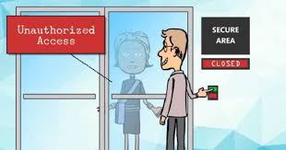





OS security issues
Physical security
Authentication
Software Vulnerabilities
Malwares
Among the issues to be considered these are the important ones:

Slide 6












Security planning
The purpose of the system, the type of information stored, the applications and services provided, and their security requirements
The categories of users of the system, the privileges they have, and the type of information they can access
How the users are authenticated
How access to the information stored on the system is managed
What access the system has to information stored on other hosts, such as file or database servers, and how it is managed
Who will administer the system, and how they will manage the system (via local or remote access)
Any additional security measures required on the system: host firewall, anti-virus,..

Slide 7
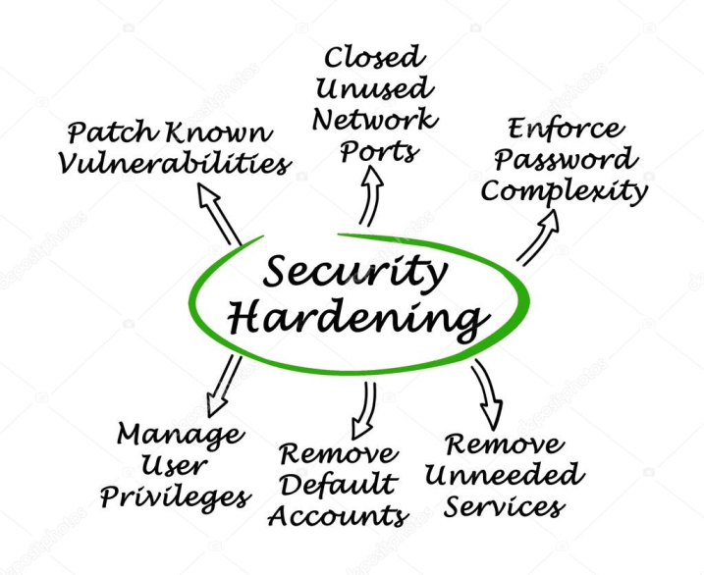
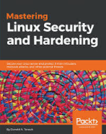
Operating Systems Hardening
Installing and patching
Configuring
Remove unnecessary applications, services and protocols
Users, groups, controls and privileges
Install additional software (anti-virus, firewall, intrusion detection system, etc.)
Test the system security
Ensure previous security configuration steps are correctly implemented
Identify any possible vulnerabilities
Quá trình tang tính bảo mật cho hệ thống

Slide 8

Installing and patching
Installation
Machines should not connect to network until secured
Limited network (firewall) is acceptable
Install only required services and drives (from trusted sources)
Set up automatic updates (only if update time is not issue)
Booting
Protect BIOS changes with password
Disable some bootable media
Cryptographic hardware drives? Pros and Cons

Slide 9
Remove unnecessary services, applications, protocols
Software have vulnerabilities, hence more software = more vulnerabilities
Better to not install it at all
Uninstallers sometimes fail to clean all dependency
Disable software may be enabled by an attacker upon control acquisition

Slide 10
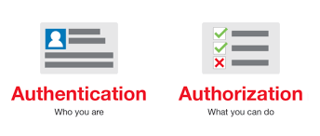









Configure users, groups, and authentication
Define user types and privileges
Admin (ideally only temporary)
Normal
Limited
Authentication
Force default password change
Password definition
Password lifespan
Not all users with access to a system will have the same access to all data and resources on that system
Remove or disable old accounts
Allow for remote connections?

Slide 11
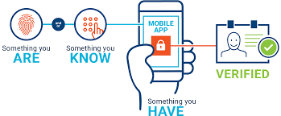

Authentication
Authentication:
Verifies user identity
Permits access to the operating system
Physical authentication
Allows physical entrance to company property
Magnetic cards and biometric measures
Digital authentication: verifies user identity by digital means

Slide 12
User administration
Create user accounts
Set password policies
Grant privileges to users
Best practices:
Use a consistent naming convention
Always provide a password to an account and force the user to change it at the first logon
Protect passwords
Do not used default passwords

Slide 13



Configure resource controls
Once the users and groups are defined, appropriate permissions can be set on data and resources

Slide 14


Authorization
Process that decides whether users are permitted to perform the functions they request
Authorization is not performed until the user is authenticated
Deals with privileges and rights

Slide 15
Additional security and Testing
Anti-virus software
Host-based Firewalls, IDS/IPS
Application white-listing

Slide 16



Test the system security
Run some test cases which attempt to break security
Ensure previous security configuration steps are correctly implemented
Identify any possible vulnerabilities

Slide 17






Application Security
Configure applications properly
Use encryption when possible as seen earlier
For storing
For transmit
Limit privileges as with users
Applications may provide backdoors if not configure properly

Slide 18





Security Maintenance
Process of maintaining security is continuous
This involves:
Monitoring and analyzing logging information
Performing regular backups
Recovering from security compromises
Regular testing for security
Patch, update, and revise critical software

Slide 19
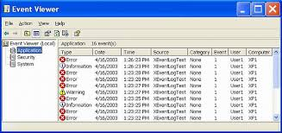
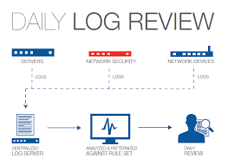
Logging
Keep a record of important events in the computer
Problems
Need to make sure to have enough space
Manual analysis is hard, so these logs should contain a format such that a program can parse messages

Slide 20














Data backup
Backup us the act of creating copies of information such that it may be recovered
Archive is to keep these backups for a long period of time in order to meet some legal aspects
Should the backup be kept online or offline?
Online makes easier access, faster recover
Offline is more secure, harder to recover
Why not both?. Users should keep their own offline backups, in case online backup gets removed
Data may be lost accidentally (hardware failures, human mistake) or intentionally

Slide 21
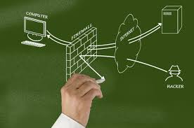
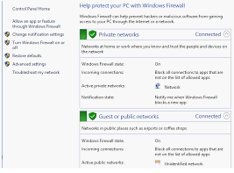




Network protection
The connectivity of operating systems to the Internet also signaled the start of a rapid increase in reported vulnerabilities.
Many OSes have built firewalls into their operating systems to reduce the ability of attackers to access network services and applications that they should not.

Slide 22


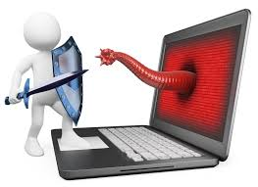
Malware protection
Malware has become an increasing issue for operating systems to deal with as users need and want to access and exchange files and applications through a variety of means, such as web portal, messaging/chat systems and social media.
Application verification and control.
Application separation - sandboxing

Slide 23
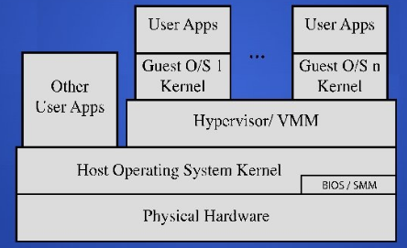
Virtualization security layers
Carefully plan the security of the virtualized system
Guest OS isolation
Virtualized environment security

Slide 24





The components of an OS security environment
OS must protect users from each other
Memory protection
File protection
General control and access to objects
User authentication
Three components
Services
Files
Memory

Slide 25





Services
Main component of operating system security environment
Used to gain access to the OS and its features
Include
User authentication
Remote access
Administration tasks
Password policies

Slide 26


Files
Common threats
File permission
File sharing
Files must be protected from unauthorized reading and writing actions

Slide 27

File permissions
Read, write, and execute privileges
In Windows:
Change permission on the Security tab on a file’s Properties dialog box
Allow indicates grant; Deny indicates revoke

Slide 28






Sharing Files
Naturally leads to security risks and threats
peer-to-peer programs: allow users to share files over the Internet
Reason for blocking file sharing:
Malicious code
Adware and spyware
Privacy and confidentiality
Copyright issues

Slide 29

Memory
Hardware memory available on the system can be corrupted by badly written software
Can harm data integrity
Two options:
Stop using the program
Apply a patch (service pack) to fix it

Slide 30










Summary
Operating system security (OS security) is the process of ensuring OS integrity, confidentiality and availability.
OS security encompasses many different techniques and methods which ensure safety from threats and attacks.
System security planning
Operating systems hardening
Initial setup and patching
Remove unnecessary services
Configure users and groups
Test system security
Application security
Application configuration
Encryption technology
Security maintenance
Data backup
Virtualization security

Slide 31
Scanning network - NMAP
Network Discovery and Security Scanning
Guide: https://nmap.org/book/toc.html

Slide 32
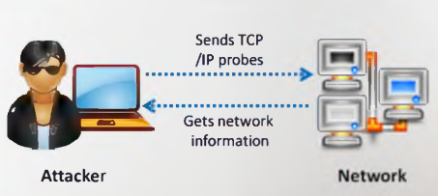
Network scanning
Network scanning refers to a set of procedures for identifying hosts, ports, and services in a network.
Network scanning is one of the components of intelligence gathering an attacker uses to create a profile of the target organization
To discover live hosts, IP address, and open ports of live hosts
To discover operating systems and system architecture
To discover services running on hosts
To discover vulnerabilities in live hosts

Slide 33
Scanning methodology
Check for live systems
Check for open ports
Scanning beyond IDS
Banner grabbing
Scanning for vulnerabilities
Draw network diagrams
Prepare proxies
Scanning Pen Testing
Check for live systems
Scan for vulnerability
Check for open ports
Draw network diagrams of vulnerabilities hosts
Identify services
Prepare proxies
Attack
Banner Grabbing/OS fingerprinting

Slide 34


OS detection, Service discovery
Sudo nmap –F <network>
sudo nmap -O <IP-target>
sudo nmap -sV <IP-target>
sudo nmap <IP-target> -A

Slide 35



Nmap vulscan
CVE stands for Common Vulnerabilities and Exposures
git clone https://github.com/scipag/vulscan scipag_vulscan
Sudo ln -s `pwd`/scipag_vulscan /usr/share/nmap/scripts/vulscan
nmap -sV --script=vulscan/vulscan.nse www.example.com
https://securitytrails.com/blog/nmap-vulnerability-scan

Slide 36
Q&A

